Slide 1
Project Proposal: Automated Cell Counting For Hemocytometer Images

Slide 2
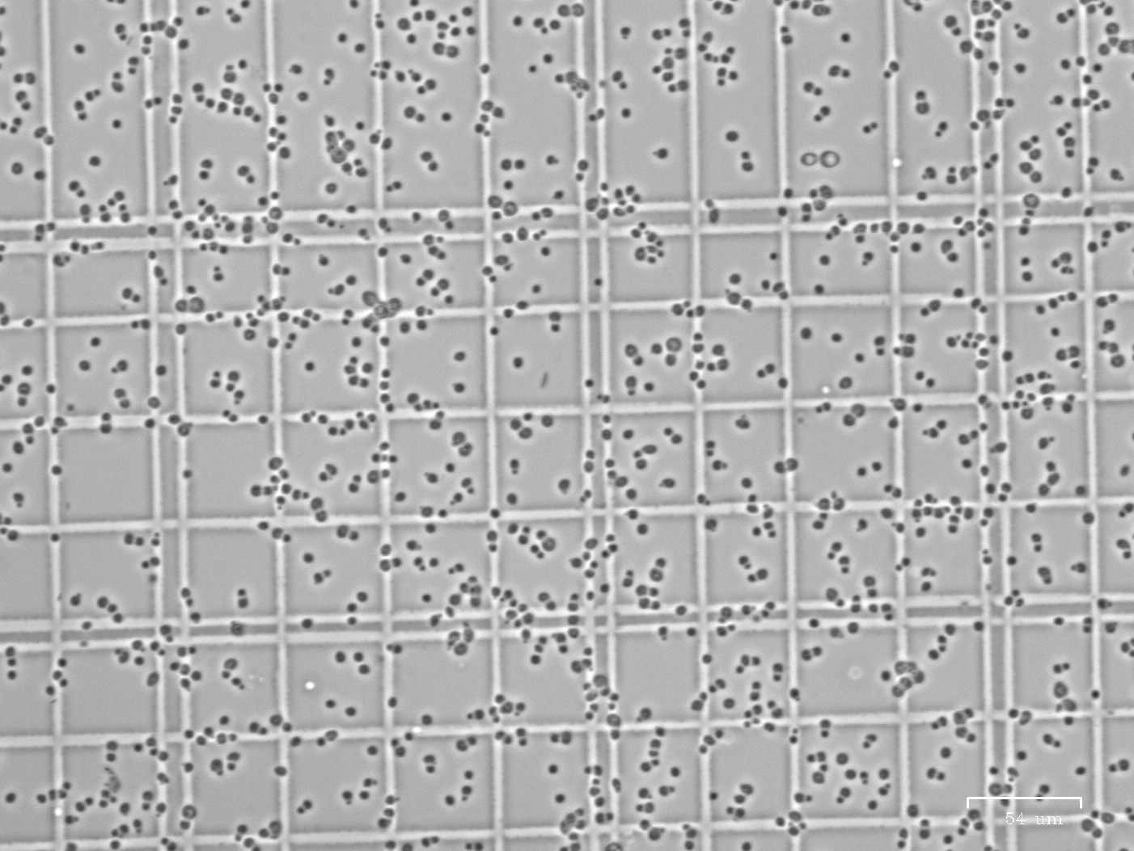
Issue: manual cell counting
Manual cell counting
Time-consuming
Inaccurate sometimes due to improper dilution factor.
Need cell count to estimate dilution
Improper dilution leads to inaccurate cell count
Trade-off between accuracy and efficiency
Not properly diluted sample

Slide 3
Proposal: Automated cell counting based on clustering algorithm
Time saving
Doesn’t require fancy equipment (automated cell counter)
Gives accurate cell count approximation based on wider range of dilution
Similar product: cell profiler
Other functions that are not needed for this particular lab purpose.
Need to adjust parameter to initiate.
Haven’t check the code out, but it’s online.
https://github.com/CellProfiler/CellProfiler-Analyst

Slide 4
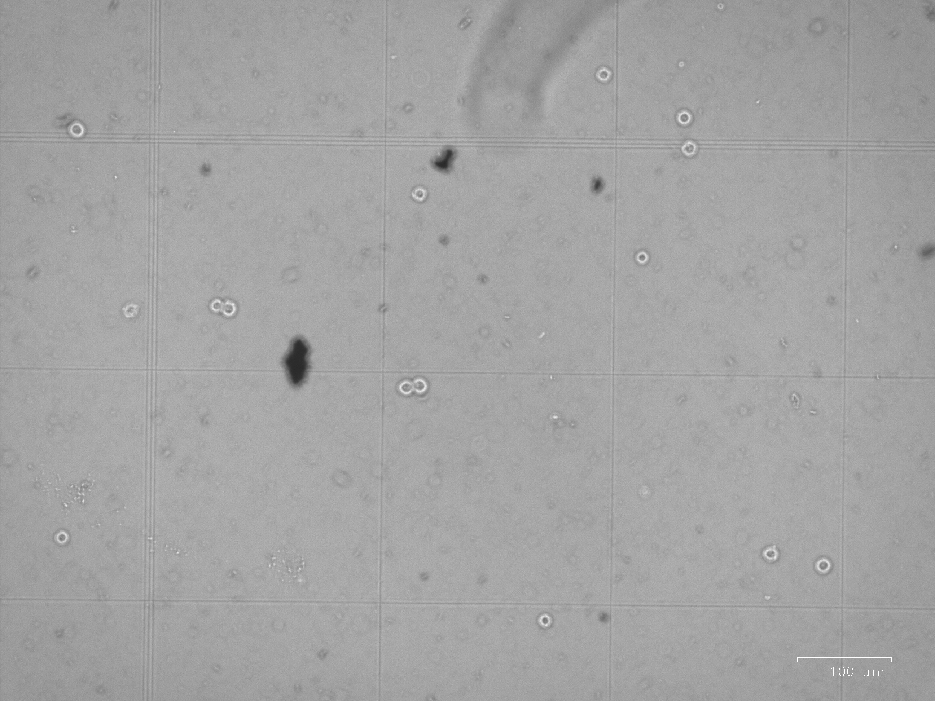
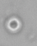
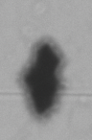
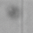
Identified problems
Differentiate viable cells from other contaminants and dead cells
Viable cells
Contaminants
Dead cells

Slide 5
Identified problems
Counting for clustered cells

Slide 6
Quick thoughts by Nicole
May consider invert the color first. (255*ones(size) - X)
Cluster by density
Identify small circles formed by the dye around viable cells.
Identify number of clusters
Radius first can be specified as user input, as normally it is a known parameter.
To develop a new feature, radius can be found by

Slide 7
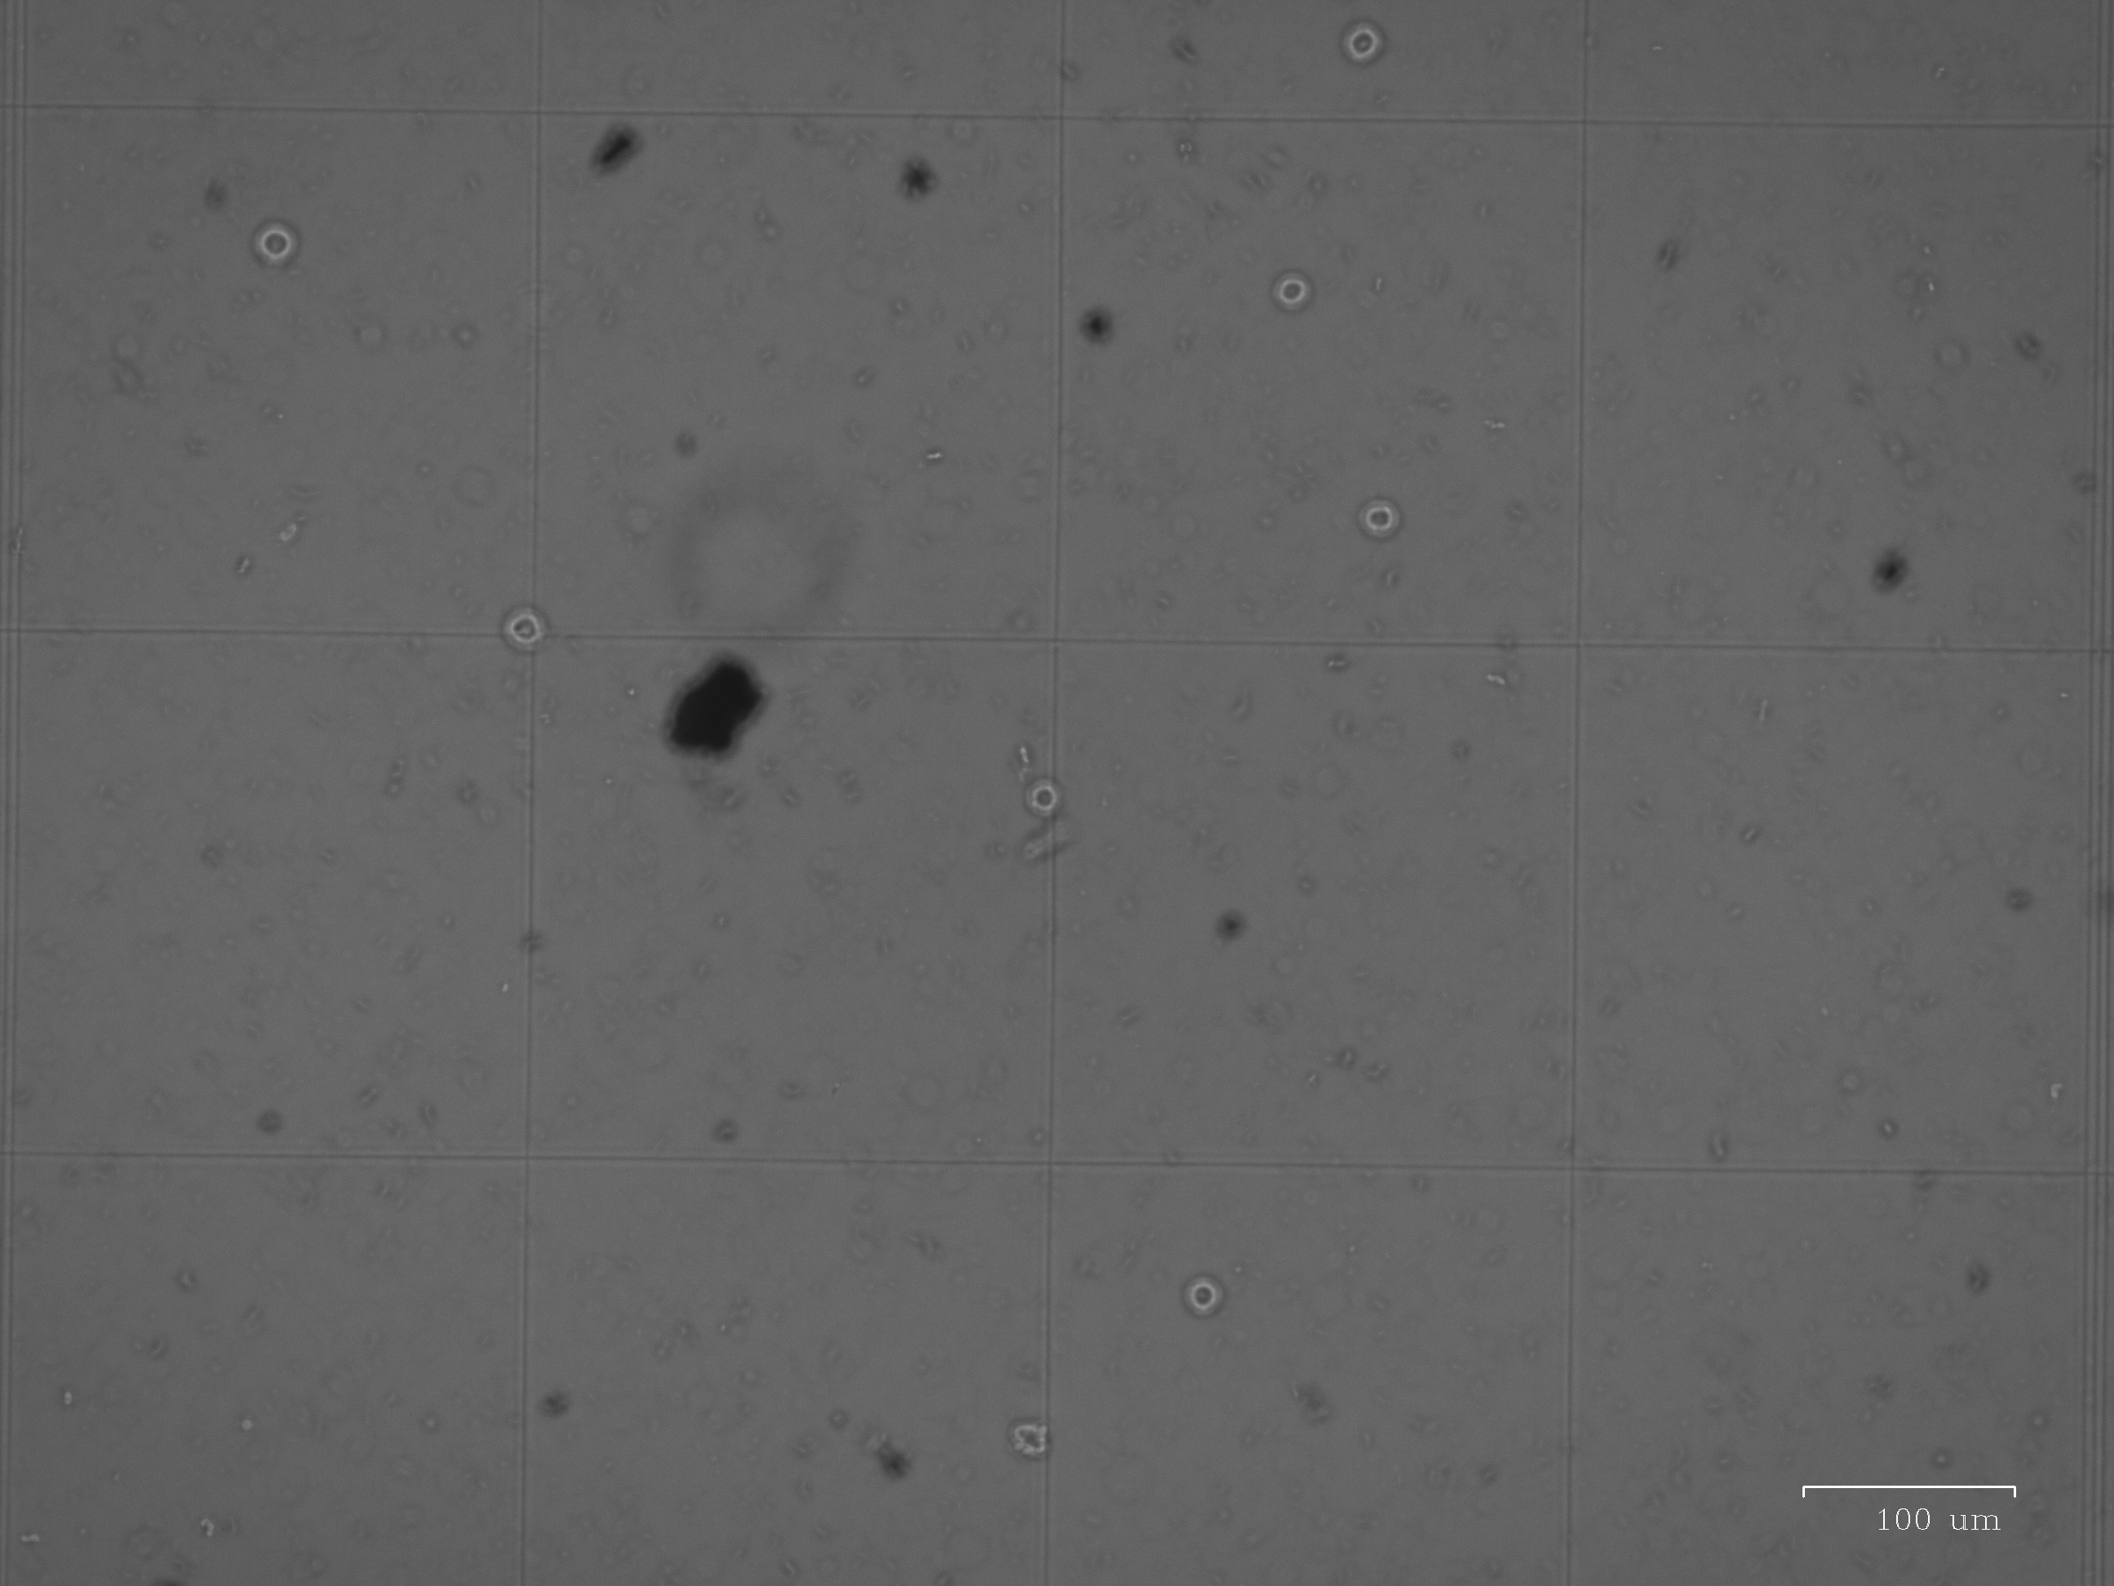
Other pictures (original picture)

Slide 8
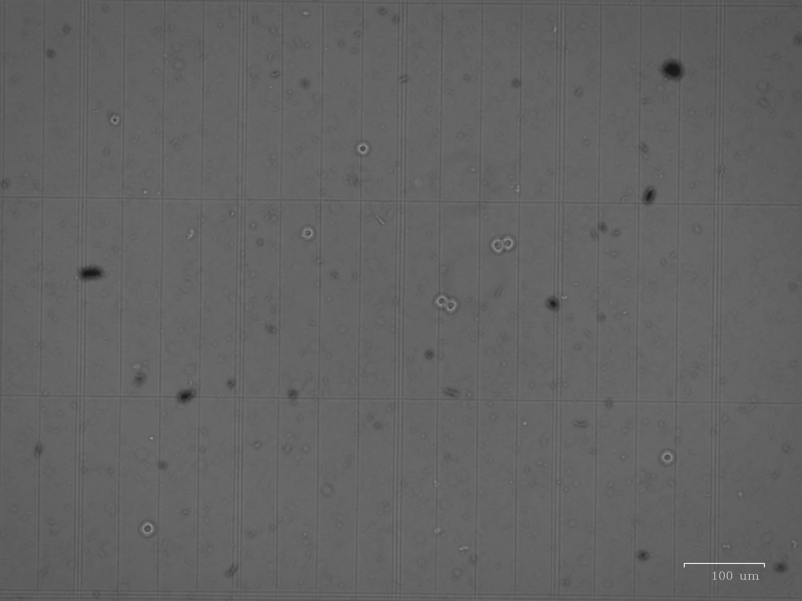
Other pictures (original picture)

Slide 9
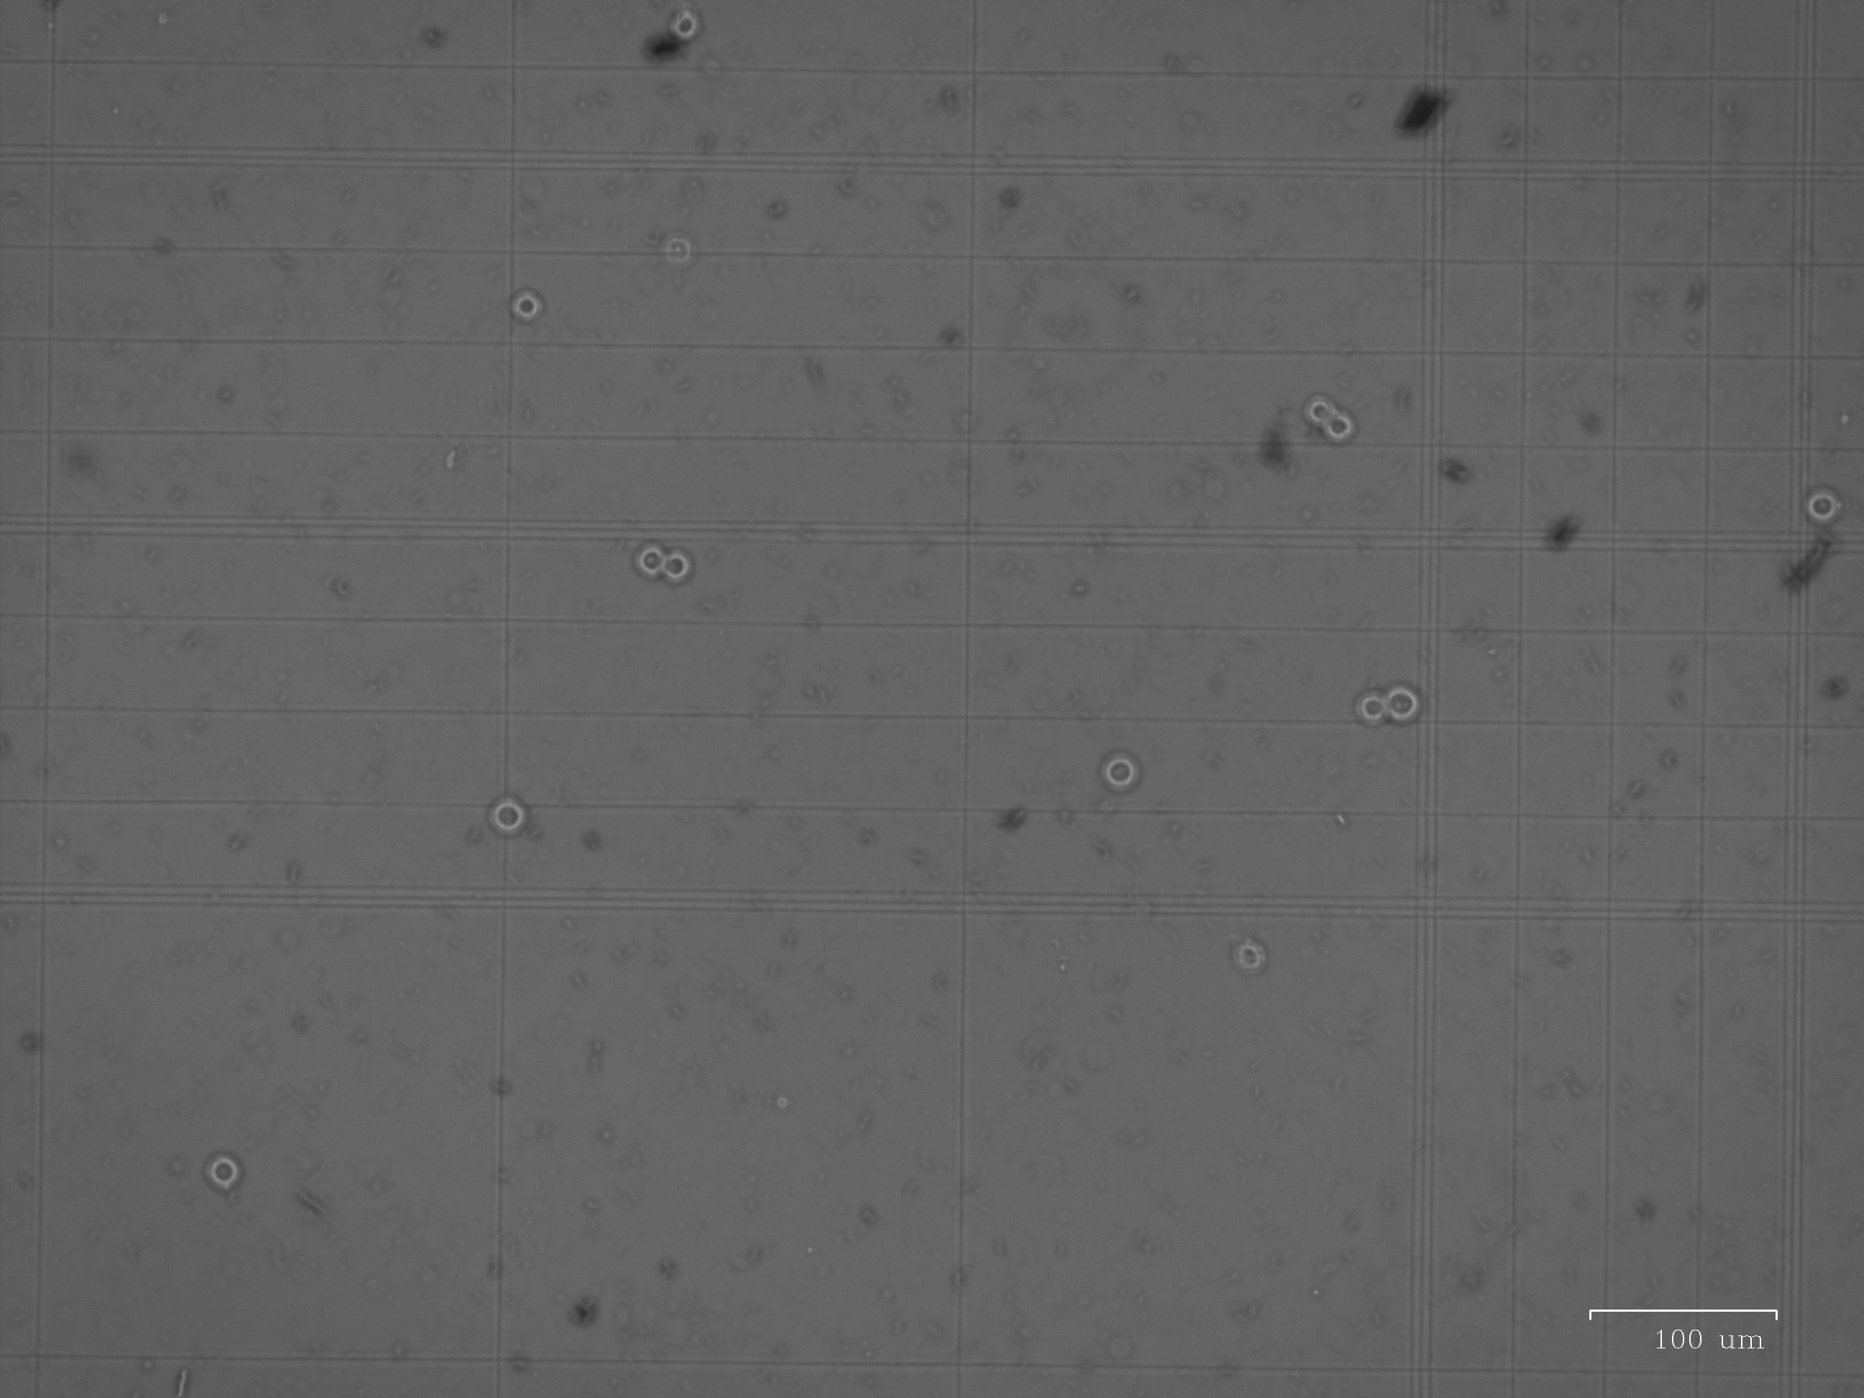
Other pictures (original picture)

Slide 10
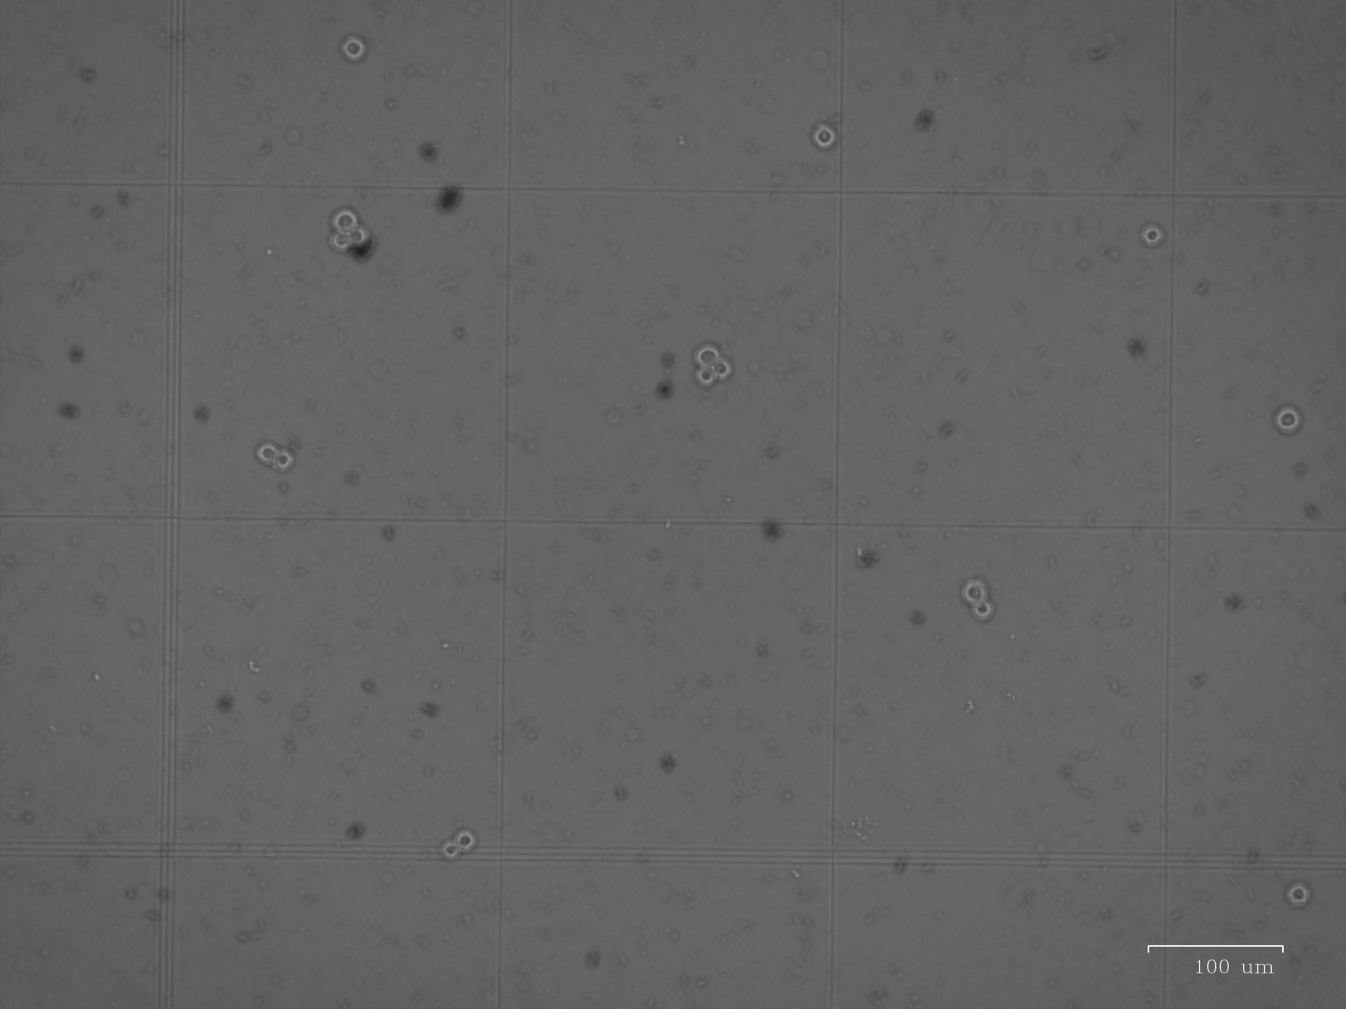
Other pictures (original picture)

Slide 11
Project Proposal: Simplified in-silica protein evolution

Slide 12
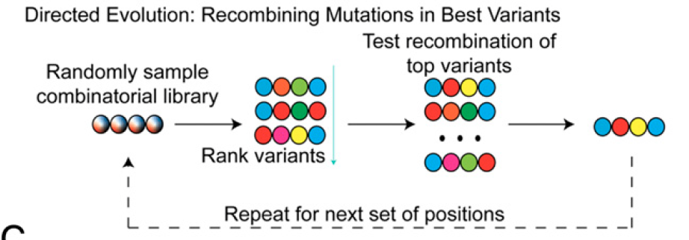
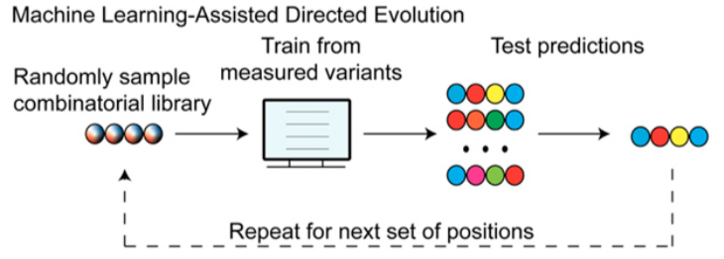
Previous work
Wu N., et al. Adaptation in protein fitness landscapes is facilitated by indirect paths (2016) reported binding affinity of protein G domain 1 (GB1) to an antibody IgG via complete mutations on 4 residues on GB1.
Propose:
Picture soruce: Wu, Zachary, S B Jennifer Kan, Russell D Lewis, Bruce J Wittmann, and Frances H Arnold. 2019. “Machine Learning-Assisted Directed Protein Evolution with Combinatorial Libraries.” Proceedings of the National Academy of Sciences 116 (18): 8852–58. doi:10.1073/pnas.1901979116.

Slide 13
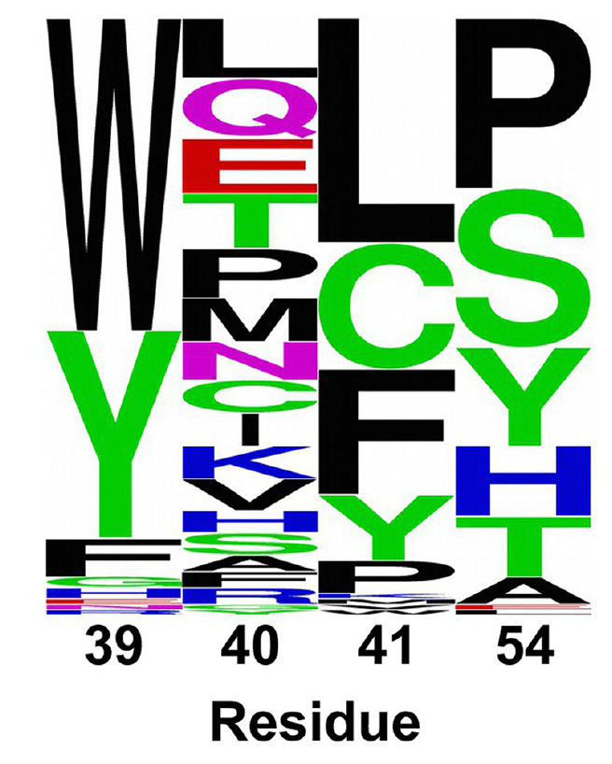
Propose: group amino acid mutations based on their function groups
20 amino acids can be classified by their functional group
Charged vs. uncharged
Positively charged
Negatively charged
Neutrally charged
Aromatic vs. non-aromatic
Steric effects (bulky vs. flexible)
Use ML to determine which factors play an important role in enhancing binding affinity using neural network.
2016. “Adaptation in Protein Fitness Landscapes Is Facilitated by Indirect Paths,” August, 1–21. doi:10.7554/eLife.16965.001.

Slide 14
Identified problems to solve
How to quantify enhanced affinity based on amino acid properties?
How to probe the probabilistic characteristic of data set?

